Slide 1
Vietnamese Sign Language Reader
using Intel® Creative Senz3D
October 2013
Notes:
Hello everyone, my name’s Duc, wc to my presentation.
Today, I would like to present my project which named ….

Slide 2
Contents
1
Introduction
2
Current approaches
3
System overview
4
Static gesture recognition
5
Dynamic gesture recognition
6
Conclusion & future works
Notes:
This is the content that we will follow strictly during the presentation
+Intro gives the fact that motivates me in carrying out this project , some info about VSL and the project proposal
+Current approaches: list main current methods in building a SLR
+Next, the system overview help you have general view about the system
+And then, the implementation of static and dynamic gesture recognition will be presented
+Conclusion & future work will end the presentation

Slide 3
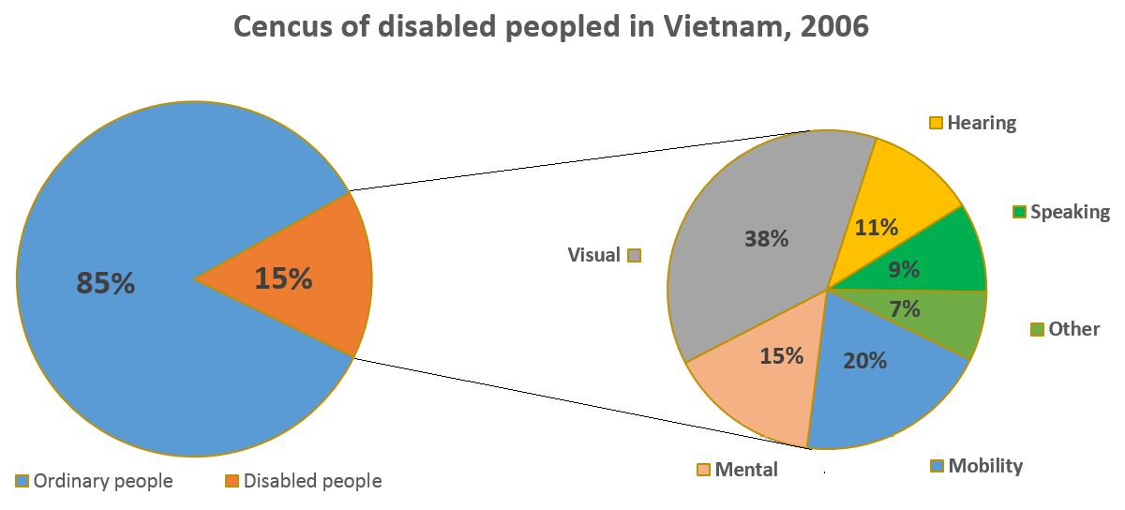
Problem definition
Vietnamese sign language
Project proposal
Introduction
Census of disable people in Vietnam, 2006
Source: Viet Nam Household Living Standards Survey 2006 conducted by General Statistics Office
Notes:
As you can see on the pie chart that shows the census of disable people in Vietnam in 2006
+ 15% of total population are disable people
+ In this 15%, people get trouble with hearing and speaking capability occupies a large part with 20%
These people get difficulty in communication as normal as we are

Slide 4
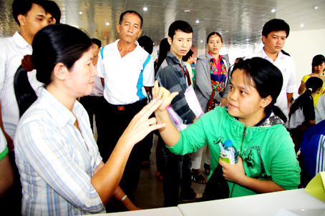
Problem definition
Vietnamese sign language
Project proposal
Introduction
Sign language is the primary way for communicating with ordinary people
Not so many people know or understand sign language
http://www.baodongnai.com.vn/
Notes:
Sign language is considered as a primary way for communicating with normal people
But unfortunately, not so many people in us know or understand sign language.
This problem results in a motivation for carrying out this project that building a tool working as a SL translator

Slide 5
Problem definition
Vietnamese sign language
Project proposal
Introduction
Static hand-gesture:
Static hand posture
Mainly describes letters in the alphabet
Dynamic hand-gesture:
A combination of static hand-gesture & movement
Describes some letters in the alphabet, a word or even a phrase
Notes:
Before go to project proposal, let explore VSL
Basically, VSL is comprised of static hand-gesture & dynamic hand-gesture.
+ The static hand-gesture is presented in static hand posture. It mainly describe letters in the alphabet
+ The dynamic hand-gesture is a series of movement in different hand shape
It could describe a word, a phrase and some letter in the alphabet.
Due to the limited of time and heavy workload for an individual project, the alphabet which includes both static & dynamic hand gesture is the focus.

Slide 6
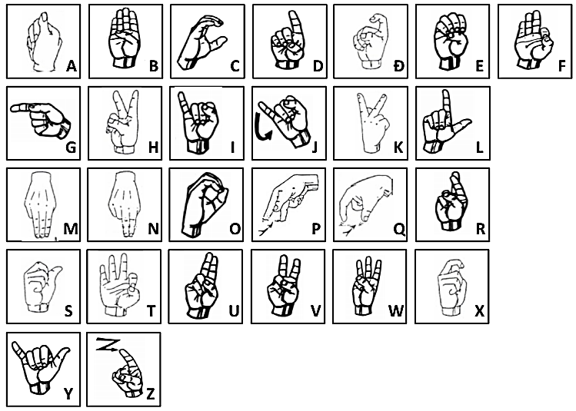
Problem definition
Vietnamese sign language
Project proposal
Introduction
23 based letters in Vietnamese writing system
4 foreign loan letters: F, J, W and Z
Notes:
+ This is a figure shows 23 based letters in VSL system & 4 foreign loan letters
+ Most letters are static hand gestures, in this figure there are only two letters: Z, J are described by dynamic hand gesture

Slide 7
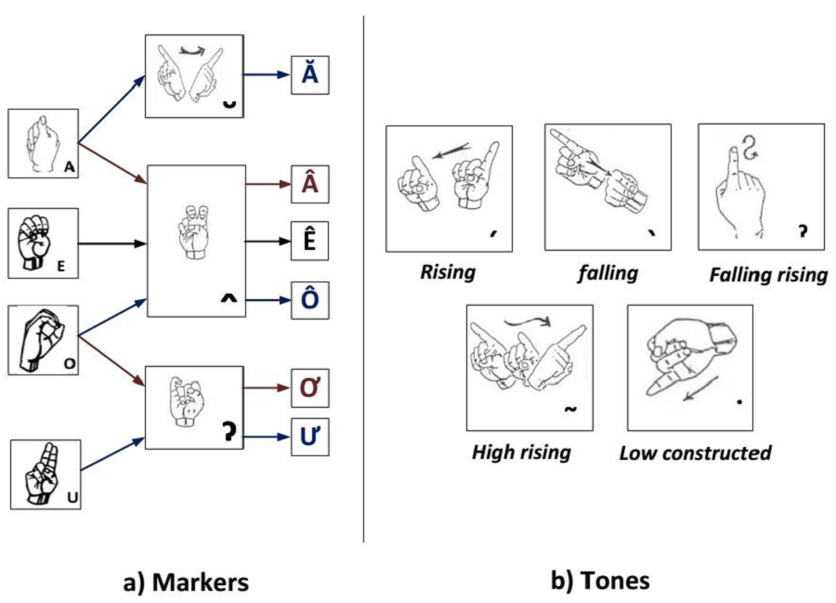
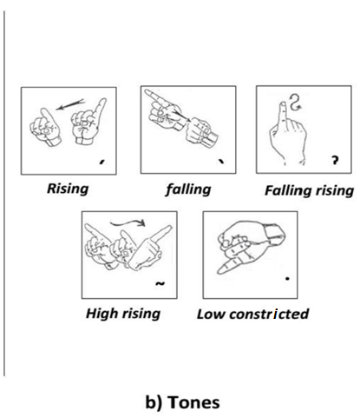
Problem definition
Vietnamese sign language
Project proposal
Introduction
3 markers added create 6 more extended vowels
5 tones
Notes:
Different from English, In Vietnamese language, the three markers will define 6 more vowels as you can see here
In addition, it also requires five tones:

Slide 8
Problem definition
Vietnamese sign language
Project proposal
Introduction
Design an automatic VSL translator
Feasible goals:
Project duration: 6 months
Recognize the 27 based letters, 3 markers and 5 tones with acceptable accuracy (>90%)
Real-time running (>10FPS)
Easy-to-use and setup for end-users
Notes:
By all information presented so far, in this project I want to design a VSL translator with the feasible goals for the 6-month project:

Slide 9
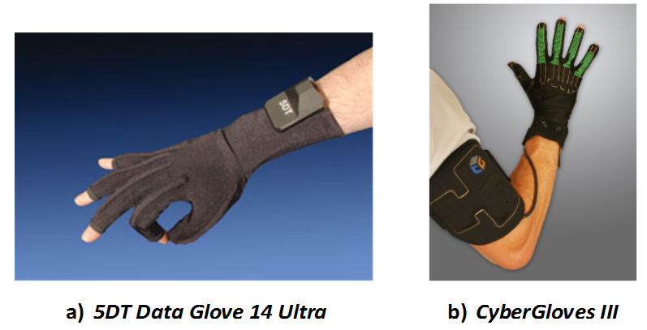
Current Approaches
Glove-based sign language recognition
Vision-based sign language recognition
Advantages:
High accuracy of recognition
Not much computation at computer side
Disadvantages:
Too expensive
Bulky to user
Easy to be damaged
$5,495
$17,795
http://www.5dt.com/
http://cyberglovesystems.com/
Notes:
Now, let turn to current approaches in building a SLR system. There are two main approaches which are glove-based and vision-based.
In Glove-base, it use electronic glove to record the signal in different hand postures and send back to computer for processing.
It provide a very high accuracy in SLR, and require not much computation at computer side.
But it would not be popularized because of its very high price, bulky to user & easy to be damage. Because of these disadvantages, this approach is not preferable in this project.

Slide 10
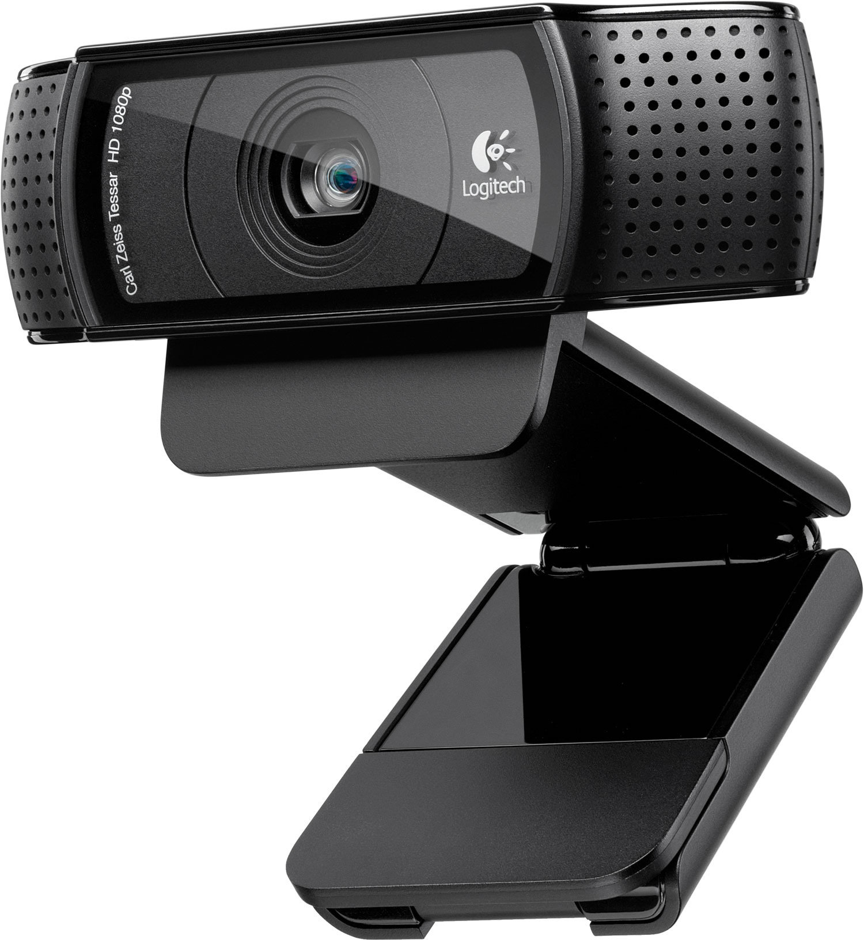
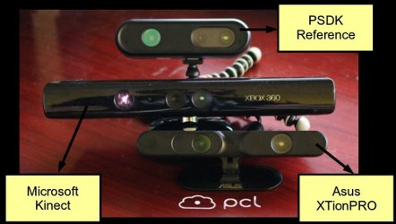
Current Approaches
Glove-based sign language recognition
Vision-based sign language recognition
2D camera:
Light sensitivity
Low accuracy
Limited to static hand-gesture
3D camera:
Light effect reduced
High accuracy
Body tracking capability
www.logitech.com/‎
pointclouds.org/‎
Notes:
In the second approach that is vision-based one, it use camera to capture hand posture and analyze gesture by implementing image processing at computer side.
In this method, there are two types of camera for you to select which are 2D and 3D camera. Although it is more expensive, the 3D camera is advanced over the 2D in term of accuracy, light sensitivity and tracking capability that is very useful for dynamic hand gesture recognition.
Consequently, the 3D camera is best selection for this project.

Slide 11
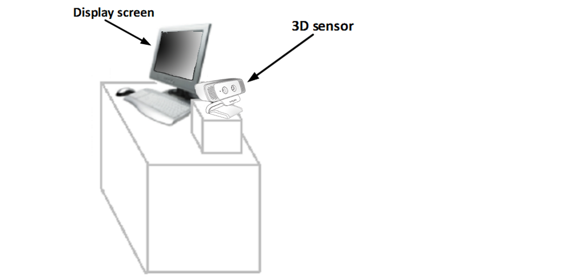
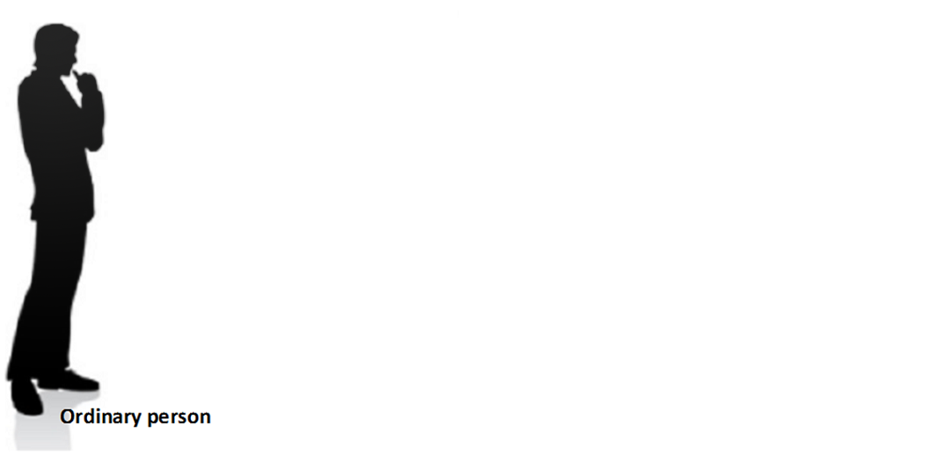
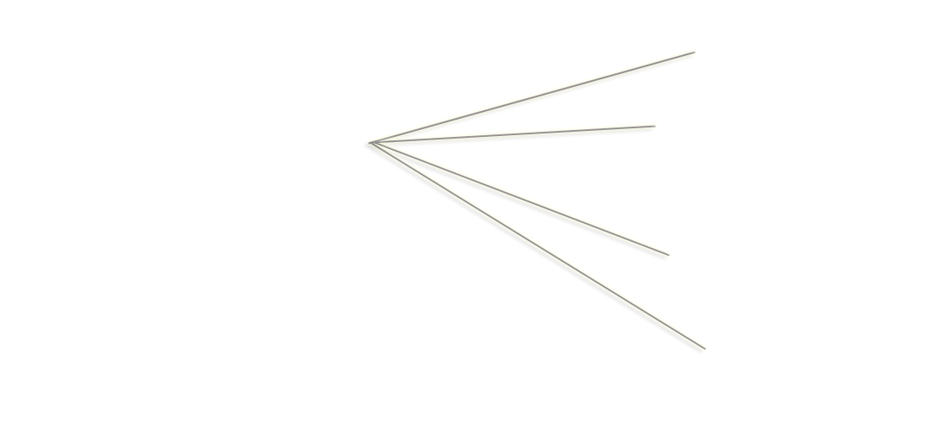
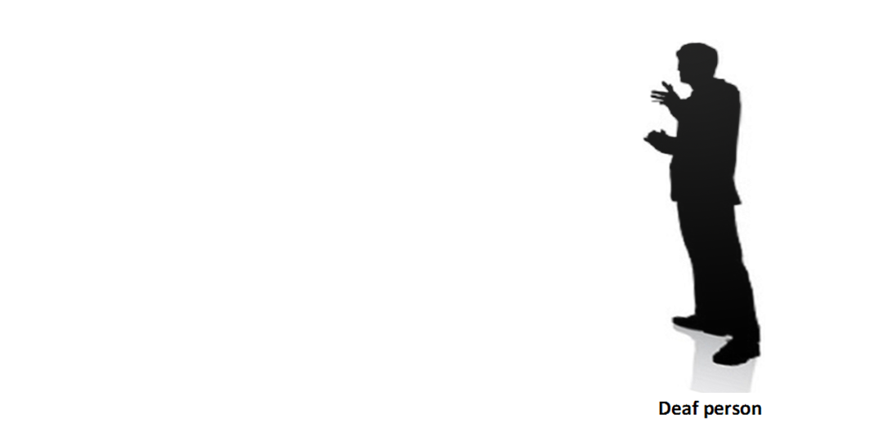

System Overview
System description
3D sensor
Software
Notes:
Now we going on the presentation with implantation part.
Let see how the system work:
+ To bridge the communication between deaf or the mute person with ordinary people, this project provides a system including a 3D sensor, a computer with screen for displaying. Whenever, the hand-gesture is detected, its corresponding text will be shown in the screen like this.

Slide 12
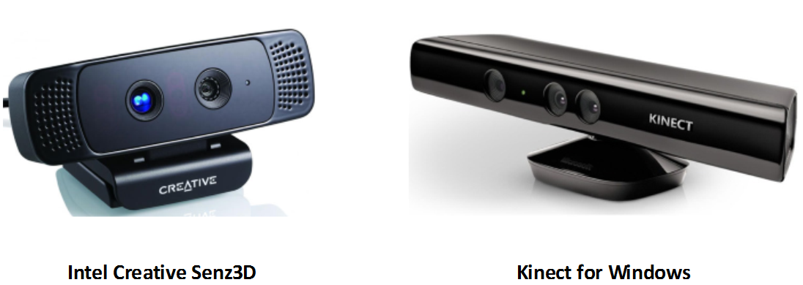


System Overview
System description
3D sensor
Software
Features |  | Intel Creative Senz3D |  | Kinect for Windows
 | Depth range | 15 ÷ 100cm |  | 40 ÷ 800cm
 | Head tracking | Intel Perceptual Computing SDK | Yes | Kinect for Windows SDK | Yes
 | Face recognition |  | Yes |  | No
 | Hand tracking |  | Yes |  | Yes
 | Finger recognition |  | Yes |  | No
Price |  | $150 |  | $250
Notes:
In term of hardware, I only focus on the 3D sensor which is the most important component.
I list the two outstanding devices for comparison.
The first one is Kinect that everyone here might know, that is a successful product of Microsoft for gamming. The second one is very new, Intel Creative Sen3D has just launched in this June, 2013. it is specifically designed for human computer interactive in close distance.
By comparing the two sensor, and considering about the project requirement, we only focus on close interaction.

Slide 13

System Overview
System description
3D sensor
Software
Software:
Compiler Visual Studio 2012
Intel Perceptual Computing SDK
OpenCV & CLAPACK library
Notes:
Regarding the software, I use the compiler VS2012, software development kit coming along with Senz3D
& libraries for image processing: OpenCV & CLAPACK

Slide 14
System specification
Pre-process module
Descriptor module
Classifier module
Results and future works
Implementation
System specifications:
Technical characteristics
Constraints (quantitative) | Value
Accuracy rate of sign language reader | >90%
Number of signs | The alphabet in VSL system (28 static hand-gestures & 7 dynamic hand-gestures)
Distance of interaction | 15-100cm
Frame per second | >10 FPS
Usage characteristics
Constraints (qualitative) | Description
Working condition | + Indoor environment + Normal light condition
System requirements | + Sensor: Intel Creative Senz3D camera + Processor: 2nd, 3rd, 4th Intel® Core™ generation + Operating system: Windows 7 Service Park 1 or higher
Easy-to-use | + Friendly user interface + Easy to setup and use

Slide 15
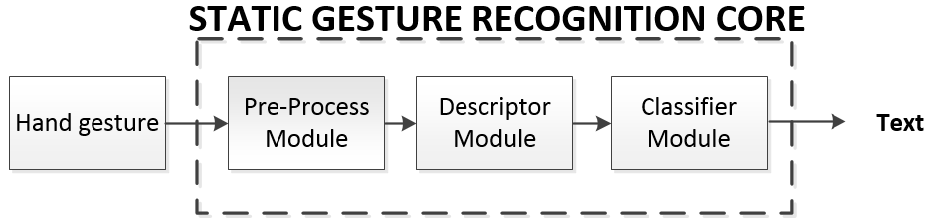
Static gesture recognition
Software flow
Pre-process module
Descriptor module
Classifier module
Results
Technique proposal: Fisher’s Linear Discriminant based [14]
Training mode
Recognizing mode
Notes:
Now, I would like you to focus on the following project flow simplified:
In this Figure, you can see the system core three modules: ….
This core could handle on two main function: training and recognizing operation.
+ Training: it work as a offline task, save the hand gesture into database for recognizing phase
+ In Recognizing operation mode, it refers to the sign database to get the most similar sign from database and display the text at output.

Slide 16
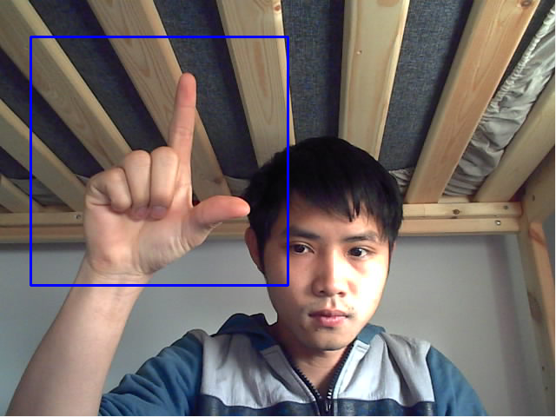
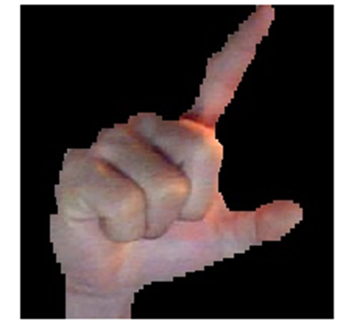

Static gesture recognition
Software flow
Pre-process module
Descriptor module
Classifier module
Results
Pre-process module
Segment hand region
Do hand normalization:
Gamma adjustment
Gaussian filter
Contrast balance
Hand segmented
Hand normalization
Notes:
Now, we go in detail each modules.
+ The pre-process module is responsible for segmenting the hand. It easily obtained by the hand tracking and 3D mapping support of the IPC SDK as mentioned previously.
+ Then the segmented hand will be processed by a sequence of image processing, including gamma correction, Gaussian filter and contrast balance. These technique will enhance the local features of the hand gesture as well as reduce the illumination effect.

Slide 17
Static gesture recognition
Software flow
Pre-process module
Descriptor module
Classifier module
Results
Descriptor module
Apply Gabor filter
Notes:
The next module is descriptor module.
This module is to extract feature of the input hand gesture. + It is first filtered by the Gabor filter. This filter is used due to its capability in acquiring features in different orientations and scales. Therefore, it the feature of each hand gesture will be more unique and it increase the accuracy of recognition.
+ This figure shows 40 image after applying the filter with 8 orientations and five scales.

Slide 18
Static gesture recognition
Software flow
Pre-process module
Descriptor module
Classifier module
Results
In training mode:
Calculate Fisher’s Linear Discriminant (FLD) space
Output: the FLD space & feature vectors with dimension reduced of all training gestures
In recognizing mode:
Project into FLD space
Output: feature vector with dimension reduced
Notes:
Next, depend on the operation mode, we have different task.
+ In the training mode, it will calculate the FLD space based on a set of training images.
This task will help reducing the dimension due to a very big dimension acquired when applying Gabor filter.
+ In the recognizing mode, the hand gesture will be projected into the FLD space to get the feature vector with lower dimension.

Slide 19
Static gesture recognition
Software flow
Pre-process module
Descriptor module
Classifier module
Results
Classifier module
Find the cosine distance
The minimum distance is the most similar hand-gesture
Notes:
The last module in system core is classifier module. This is only used in the recognizing operation mode.
In this module the cosine distance is used for comparing the input hand gesture vector with database to find best match and display the corresponding text on the screen.

Slide 20
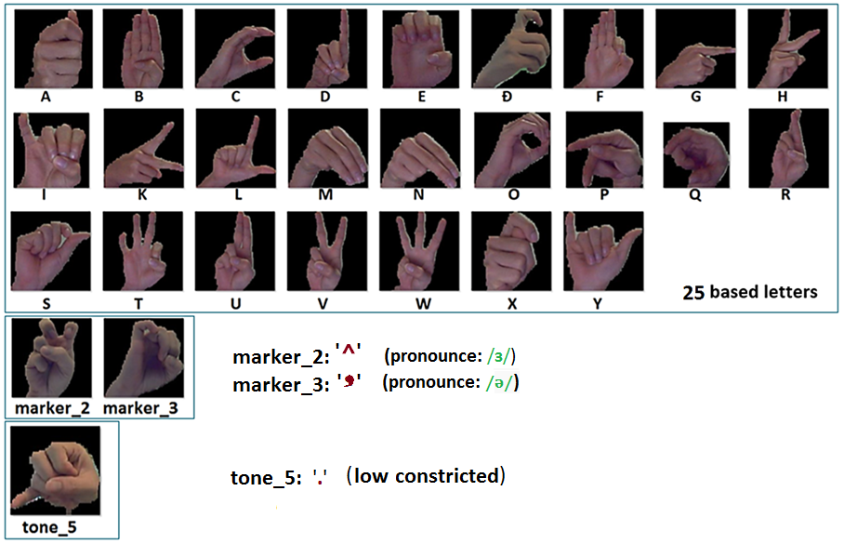
Static gesture recognition
Software flow
Pre-process module
Descriptor module
Classifier module
Results
28 static gestures
Notes:
The presented techniqure will be applied for the following 28 static gesture including 25 based letters, two markers and one tone

Slide 21
Static gesture recognition
Software flow
Pre-process module
Descriptor module
Classifier module
Results
Database building:
Each sign requires 15 training images (total need: 28*15 = 420)
Training images include different angle and distance to Senz3D
Test plan:
Each sign will be examined 15 times on 3 people
Average accuracy
Results:
The accuracy rate is up to 93.89% in a normal light condition
Recognizing speed: 14 FPS
Notes:
About the database building, each sign will have 15 training images therefore we need 420 images in total for 28 signs
The training image is capture in different angle and distance to Senz3D
For the test plan, each sign will be examined 15 time on 3 different people in normal light condition to get the average accuracy
And the achieved result is quite good with 94%. & and the running speed is up to 14FPS

Slide 22
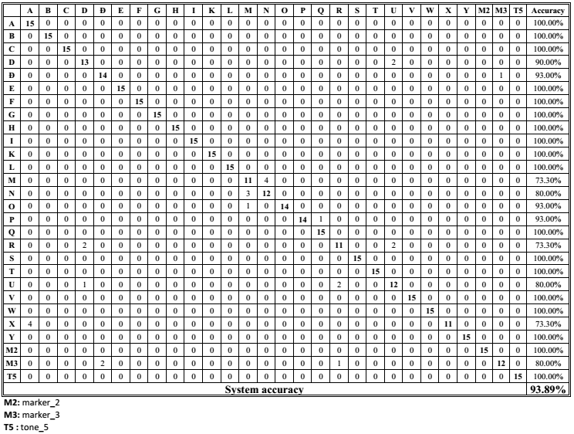

Slide 23


Slide 24
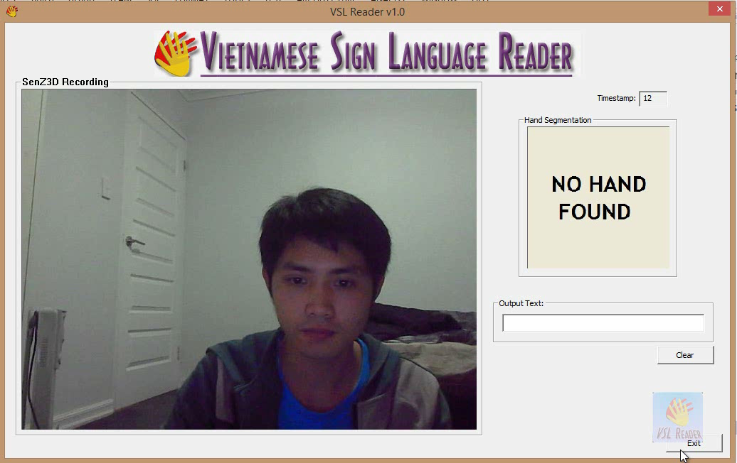
System specification
Pre-process module
Descriptor module
Classifier module
Results and future works
Implementation
Notes:
This is a demonstration video shows how I achieve the results.

Slide 25
Dynamic gesture recognition
Software flow
Input data module
Normalization module
Classifier module
Results
Technique proposal: $1 recognizer based [16]
Training mode
Recognizing mode
Notes:
Now, we move to the dynamic gesture recognition. Similar to the –static one, the flow is built for two purposes: trainning and recognizing.
+ Training: it work as a offline task, save the hand gesture into database for recognizing phase
+ In Recognizing operation mode, it refers to the sign database to get the most similar sign from database and display the text at output.

Slide 26
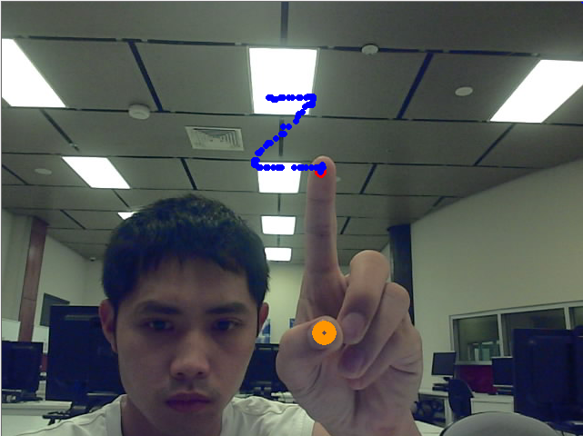
Dynamic gesture recognition
Software flow
Input data module
Normalization module
Classifier module
Results
Input data module:
Track finger tip movement
Store 2D points to an array
Notes:
It is responsible for acquiring input data by tracking the finger tip movement which creates a series of points
And these points are stored in 2D dimensional format for later process

Slide 27
Dynamic gesture recognition
Software flow
Input data module
Normalization module
Classifier module
Results
Normalization module
Sampling & scaling input data
Translating to the local centroid coordinate
Sampling & Scaling
80
80
Translating
Notes:
Firstly, the input data will be extracted from the image coordinate. It is then sampled and scaled to reduce computation and give a better speed. Here it is scaled to a fix square, 80x80 pixels. Finally, the origin will be moved the central of square.
By configuration like this, all gestures could be compared with each other.

Slide 28
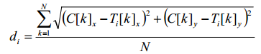
Dynamic gesture recognition
Software flow
Input data module
Normalization module
Classifier module
Results
Classifier module
C : set of candidate points
T : a set of template points
N: number of points of one gesture
Find the Euclidean distance
The minimum distance is the most similar hand-gesture
Notes:
At the classifier module,

Slide 29
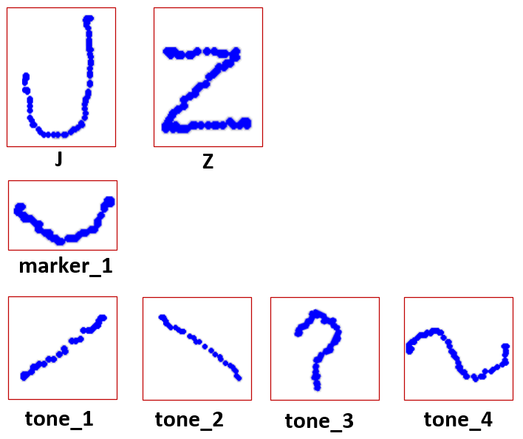
Dynamic gesture recognition
Software flow
Input data module
Normalization module
Classifier module
Results
7 dynamic gestures
Notes:
Here are 7 dynamic gesture will be implemented

Slide 30
Dynamic gesture recognition
Software flow
Input data module
Normalization module
Classifier module
Results
Database building:
Each sign requires only 1 training template (total need: 7 )
Test plan:
Each sign will be examined 15 times on 3 people
Average accuracy
Results:
The accuracy rate is up to 97.14%
Recognizing speed: 15 FPS
Notes:
For the data building, because of small set

Slide 31
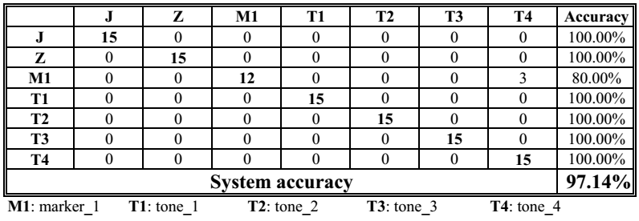
Dynamic gesture recognition
Software flow
Input data module
Normalization module
Classifier module
Results
The accuracy rate is up to 97.14%

Slide 33
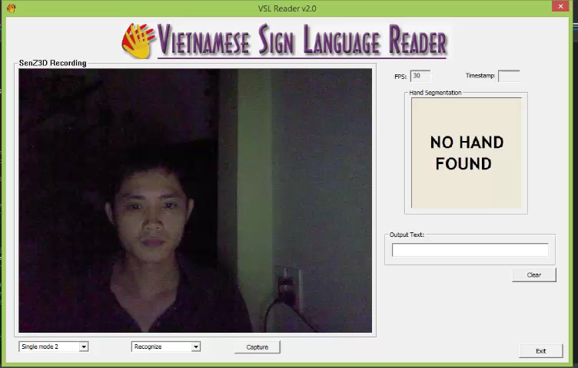

Slide 34
Conclusion & Future works
Conclusion
Future works
Sign language is a primary way in communication for the deaf/mute
Two main approaches: ‘glove-based’ & ‘vision-based’
VSL is comprised of static and dynamic hand-gesture
Successfully implement the static & dynamic hand-gesture recognition for alphabet, markers and tones in VSL system
The accuracy rate achieved is above 90%
Notes:
]

Slide 35

Conclusion & Future works
Conclusion
Future works
Improve the operational speed and accuracy
Implement the combination working mode
Develop the program for other platforms: Windows RT, iOS and Android
Extend the dictionary with more gesture not only for Vietnamese but for other languages

Slide 36
REFERENCES
[1] "Comprehensive Results on the Household Living Standards Survey 2006 ", S. R. o. V. N. General Statistics Office, Ed., ed: Hanoi Statistical Publishing House, 2006.
[2] P. B. Braem, Einführung in die Gebärdensprache und ihre Erforschung: Signum-Verlag, 1995.
[3] K. Fain, Handsigns: A Sign Language Alphabet: Chronicle Books, 1995.
[4] V. B. Le, E. C. Do Dat Tran, E. Castelli, L. Besacier, and J.-F. Serignat, "Spoken and Written Language Resources for Vietnamese," in LREC, 2004, pp. 599-602.
[5] 5DT Data Glove 14 Ultra. Available: http://www.5dt.com/products/pdataglove14.html
[6] (2 August). Xtion PRO LIVE (4001). Available: http://us.estore.asus.com/index.php?l=product_detail&p=3397
[7] (2 August). Kinect for Xbox 360. Available: http://www.microsoftstore.com/store/msusa/en_US/pdp/Kinect-for-Xbox-360/productID.253169000
[8] I. Corporation, "Intel® Perceptual Computing SDK Human Interface Guidelines," 2013.
[9] C. T. Ltd, "InteractIve Gesture camera for your PC," 2013.
[10] X. Tan and B. Triggs, "Enhanced local texture feature sets for face recognition under difficult lighting conditions," in Analysis and Modeling of Faces and Gestures, ed: Springer, 2007, pp. 168-182.
[11] D.-Y. Huang, W.-C. Hu, and S.-H. Chang, "Vision-based hand gesture recognition using PCA+ Gabor filters and SVM," in Intelligent Information Hiding and Multimedia Signal Processing, 2009. IIH-MSP'09. Fifth International Conference on, 2009, pp. 1-4.

Slide 37
REFERENCES
[12] W. Zhang, S. Shan, W. Gao, X. Chen, and H. Zhang, "Local Gabor binary pattern histogram sequence (LGBPHS): A novel non-statistical model for face representation and recognition," in Computer Vision, 2005. ICCV 2005. Tenth IEEE International Conference on, 2005, pp. 786-791.
[13] K. Yan, Y. Chen, and D. Zhang, "Gabor Surface Feature for face recognition," in Pattern Recognition (ACPR), 2011 First Asian Conference on, 2011, pp. 288-292.
[14] C. Liu and H. Wechsler, "Gabor feature based classification using the enhanced fisher linear discriminant model for face recognition," Image processing, IEEE Transactions on, vol. 11, pp. 467-476, 2002.
[15] K. Fukunaga, Introduction to statistical pattern recognition: Access Online via Elsevier, 1990.
[16] J. O. Wobbrock, A. D. Wilson, and Y. Li, "Gestures without libraries, toolkits or training: a $1 recognizer for user interface prototypes," in Proceedings of the 20th annual ACM symposium on User interface software and technology, 2007, pp. 159-168.

Slide 38
Thank You
Q&A

